Slide 1

Case Studies
Why look at case studies?
deeplearning.ai

Slide 2
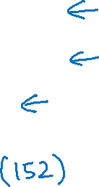
Outline
Classic networks:
LeNet-5
AlexNet
VGG
ResNet
Inception

Slide 3
Case Studies
Classic networks
deeplearning.ai

Slide 4
LeNet - 5
avg pool
avg pool
$$\hat{y}$$
5$×$ 5
s = 1
f = 2
s = 2
5$×$ 5
s = 1
f = 2
s = 2
$$⋮$$
$$⋮$$
32$×$32 $×$1
28$×$28$×$6
14$×$14$×$6
10$×$10$×$16
5$×$5$×$16
120
84
[LeCun et al., 1998. Gradient-based learning applied to document recognition]

Slide 5
AlexNet
MAX-POOL
MAX-POOL
11$×$ 11
s = 4
3$×$ 3
s = 2
5$×$ 5
same
3$×$ 3
s = 2
55$×$55 $×9$6
27$×$27 $×$96
27$×$27 $×$256
13$×$13 $×$256
227$×$227 $×$3
MAX-POOL
=
3$×$ 3
same
3$×$ 3
3$×$ 3
3$×$ 3
s = 2
$$⋮$$
$$⋮$$
$$⋮$$
Softmax
1000
13$×$13 $×$384
13$×$13 $×$384
13$×$13 $×$256
6$×$6 $×$256
9216
4096
4096
[Krizhevsky et al., 2012. ImageNet classification with deep convolutional neural networks]

Slide 6
VGG - 16
CONV = 3$×$3 filter, s = 1, same
MAX-POOL = 2$×$2 , s = 2
224$×$224$×$64
112$×$112 $×$64
112$×$112 $×$128
56$×$56 $×$128
[CONV 64]
$×$2
POOL
[CONV 128]
$×$2
POOL
224$×$224 $×$3
56$×$56 $×$256
28$×$28 $×$256
28$×$28 $×$512
14$×$14$×$512
[CONV 256]
$×$3
POOL
[CONV 512]
$$×3$$
POOL
14$×$14 $×$512
7$×$7$×$512
FC
FC
Softmax
[CONV 512]
$×$3
POOL
4096
4096
1000
[Simonyan & Zisserman 2015. Very deep convolutional networks for large-scale image recognition]

Slide 7
Residual Network
$$x$$
$$a^{[l]}$$
Plain
ResNet
training error
training error
# layers
# layers
[He et al., 2015. Deep residual networks for image recognition]

Slide 8
Case Studies
Residual Networks (ResNets)
deeplearning.ai

Slide 9
Residual block
$$a^{[l+1]}$$
$$a^{[l]}$$
$$a^{[l+2]}$$
$$z^{[l+1]}{=W}^{[l+1]}a^{[l]}+b^{[l+1]}$$
$$a^{[l+1]}=g(z^{[l+1]})$$
$$z^{[l+2]}= W^{[l+2]}a^{[l+1]}+b^{[l+2]}$$
$$a^{[l+2]}=g(z^{[l+2]})$$
[He et al., 2015. Deep residual networks for image recognition]

Slide 10
Residual Network
$$x$$
$$a^{[l]}$$
Plain
ResNet
training error
training error
# layers
# layers
[He et al., 2015. Deep residual networks for image recognition]

Slide 11
Case Studies
Network in Network and 1$×$1 convolutions
deeplearning.ai

Slide 12
Why does a 1 $×$ 1 convolution do?
1 | 2 | 3 | 6 | 5 | 8
3 | 5 | 5 | 1 | 3 | 4
2 | 1 | 3 | 4 | 9 | 3
4 | 7 | 8 | 5 | 7 | 9
1 | 5 | 3 | 7 | 4 | 8
5 | 4 | 9 | 8 | 3 | 5
$$∗$$
2
$$=$$
6 $×$ 6
$$∗$$
$$=$$
6 $×$ 6 $×$ 32
1 $×$ 1 $×$ 32
6 $×$ 6 $×$ # filters
[Lin et al., 2013. Network in network]

Slide 13
Using 1$×$1 convolutions
ReLU
CONV 1 $×$ 1
32
28 $×$ 28 $×$ 32
28 $×$ 28 $×$ 192
[Lin et al., 2013. Network in network]

Slide 14
Case Studies
Inception network motivation
deeplearning.ai

Slide 15
Motivation for inception network
1 $×$ 1
3 $×$ 3
64
5 $×$ 5
128
28
32
32
28
28 $×$ 28 $×$ 192
MAX-POOL
[Szegedy et al. 2014. Going deeper with convolutions]
Note: the colors are intended to correspond to the stacked small hand drawn cube

Slide 16
The problem of computational cost
CONV
5 $×$ 5,
same,
32
28 $×$ 28 $×$ 32
28 $×$ 28 $×$ 192

Slide 17
Using 1$×$1 convolution
CONV
1 $×$ 1,
16,
1 $×$ 1 $×$ 192
CONV
5 $×$ 5,
32,
5 $×$ 5 $×$ 16
28 $×$ 28 $×$ 16
28 $×$ 28 $×$ 32
28 $×$ 28 $×$ 192

Slide 18
Case Studies
Inception network
deeplearning.ai

Slide 19
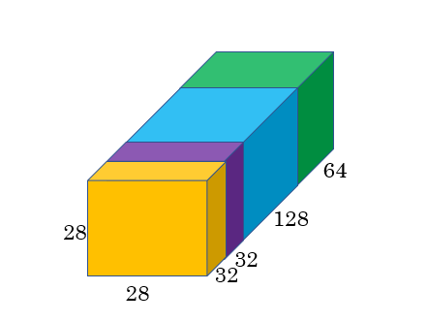
Inception module
1 $×$ 1 CONV
1 $×$ 1 CONV
3 $×$ 3 CONV
Previous Activation
Channel Concat
1 $×$ 1 CONV
5 $×$ 5 CONV
MAXPOOL 3 $×$ 3,s = 1 same
1 $×$ 1 CONV

Slide 20
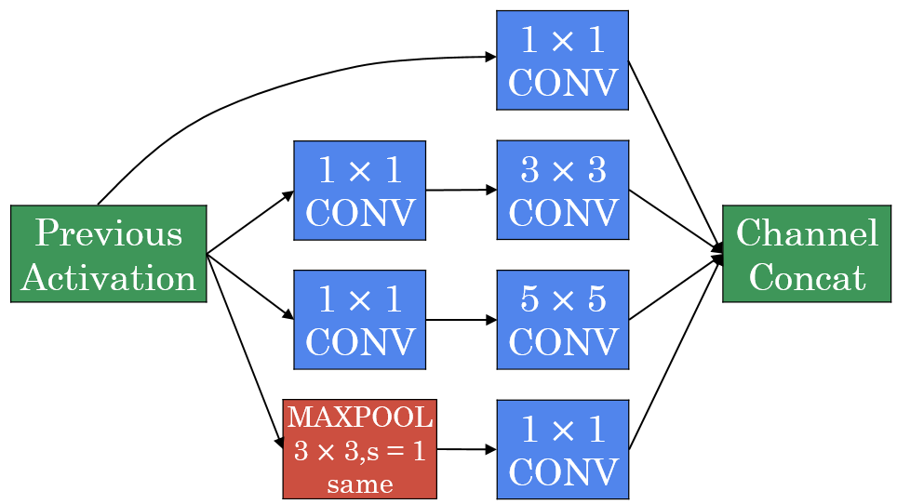

Inception network
[Szegedy et al., 2014, Going Deeper with Convolutions]

Slide 21
http://knowyourmeme.com/memes/we-need-to-go-deeper

